Slide 1
CIS 3710
SYSTEMS ANALYSIS
& DESIGN
Milestone 1

Slide 2
Kaitaia Publishing Collective
Haris Khan, Konan Kouame, Ryan Horwitz, Christopher Luzzi, Benjamin Jackson

Slide 3
Introduction
Software Unlimited - Kaitaia Publishing Collective Case
Manuscripting
Publishing collective system
Sales, marketing and distribution
Payments to authors

Slide 4
System Request
Purpose - New system would prove beneficial to company and would aid in preventing and eliminating costly errors from occurring
Business Needs - New system would reduce time taken on tasks by making Database logs automated. Database Logs would also detect errors beforehand to eliminate the possibility of costly errors.
Annual Benefits - Throughout a four year period the company should expect to see an increase in productivity and sales with this new system in place.
Increase in sales by 9% starting at $50,000
Numerous tangible and intangible benefits
Tangible benefits include increase in sales, resource cost savings, and increase in productivity.
Intangible benefits include increase in market share, boosted public image, and increased customer satisfaction.

Slide 5

Feasibility Analysis
Organizational
Technical
Economic
A more organized and efficient work environment
Fits the Committee’s guidelines
Return on Investment after ~3.5 years

Slide 6
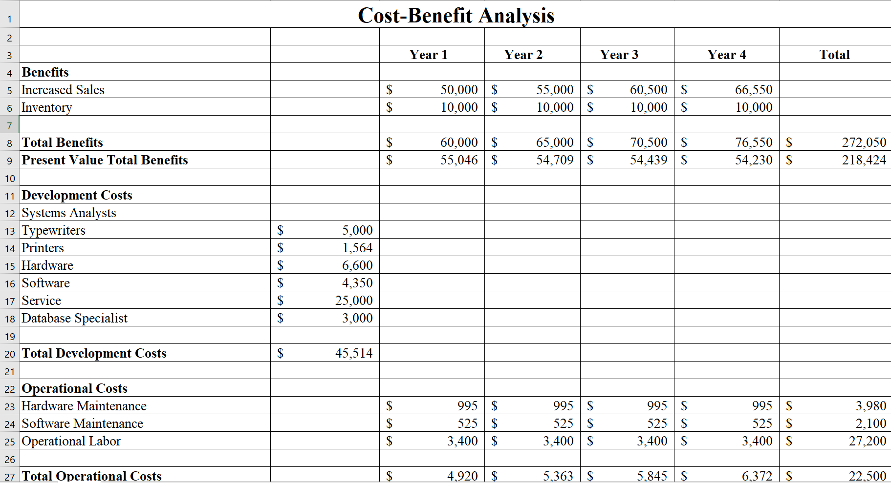

Slide 7
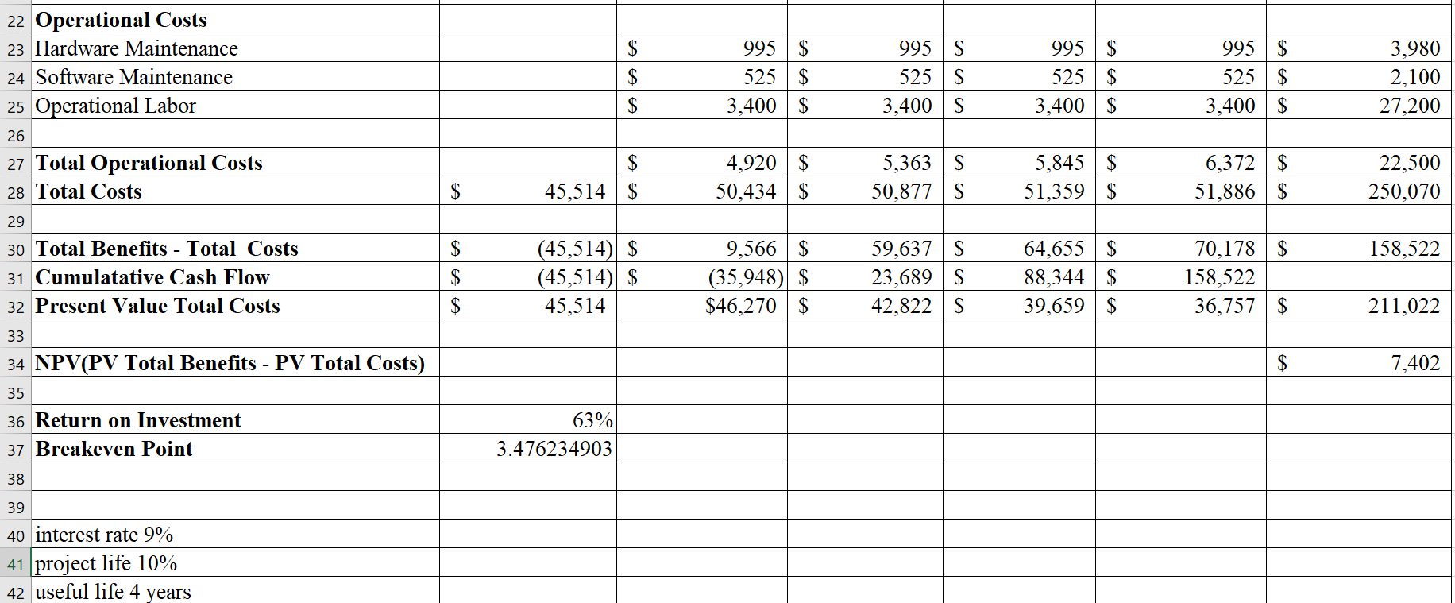

Slide 8
Project Recommendation
Reduced errors and anomalies during the publishing process.
Increase the amount of new authors using Kaitaia Publishing.
Improved tracking of sales, marketing, distribution, and inventory of manuscripts.
ROI will be 63%
Break-even point around 3 years and 5 months

Slide 9
Thank you!

